Slide 1

The Price of Care: Understanding America’s Childcare Affordability Crisis
By: Joanna Sierra-Mendoza

Slide 2
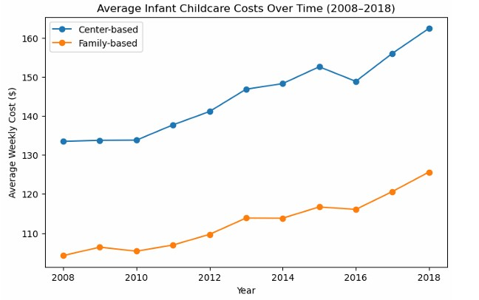
Average Childcare Cost Over Time
Center-Based Care (MCInfant): Care provided in licensed childcare centers with structured staff, facilities, and standardized programs.
Family-Based Care (MFCCInfant): Home-based childcare provided by individuals caring for small groups of children.
Both center-based and family-based infant care costs have steadily increased since 2008, with center-based care consistently remaining more expensive.
By 2018, weekly costs for center-based care exceeded $150, compared to around $120 for family-based care, indicating a growing affordability gap.

Slide 3
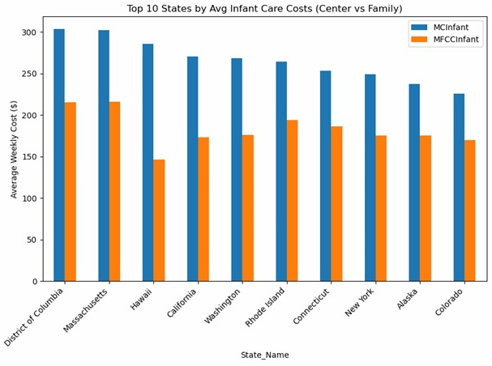
Most Expensive States for Child Care
Highest-cost states: Massachusetts, Hawaii, and California exceeded $270 per week for center-based infant care.
Lowest-cost states: Mississippi, Arkansas, and Alabama averaged under $110 per week for the same care.
The Northeast and West Coast consistently rank as the most expensive regions, while the South and Midwest remain the most affordable.
Center-based care averaged 30-50% higher than family-based care across nearly all states.

Slide 4
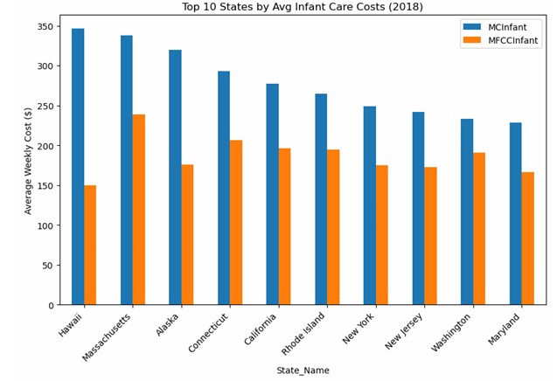
Most Expensive States for 2018
Hawaii led the nation in average weekly childcare costs for 2018.
Families in high-cost states faced expenses nearly triple those in lower-cost regions.
Without stronger affordability policies, regional disparities will continue to limit equal access to quality childcare.

Slide 5
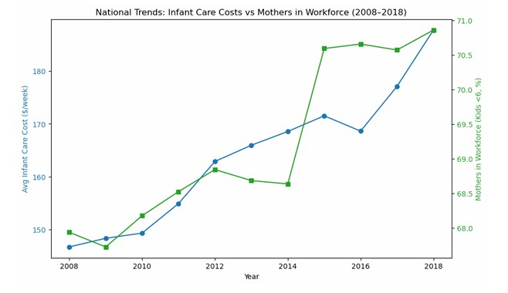
Workforce Participation vs Childcare Costs
Between 2008 and 2018, the average weekly cost of infant childcare increased significantly while workforce participation among mothers with children under six remained nearly stagnant. The data reveal that despite economic recovery and rising employment rates during the decade, childcare affordability did not improve for families.
Higher childcare costs reduce mothers’ labor force participation, with the strongest effects among lower-income mothers.

Slide 6

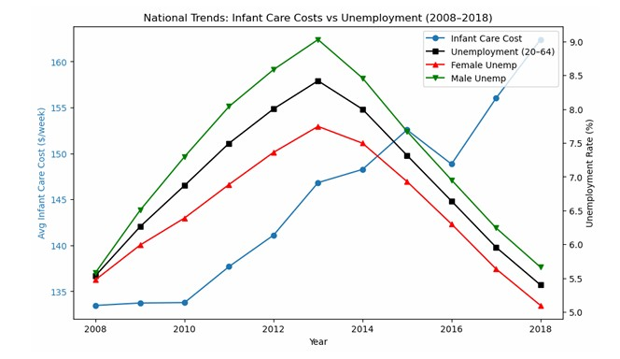


Unemployment vs Childcare Costs
Childcare costs continued to rise even during periods of fluctuating unemployment. This reflects on how childcare pricing operates independently from employment trends, highlighting system issues in affordability.

Slide 7
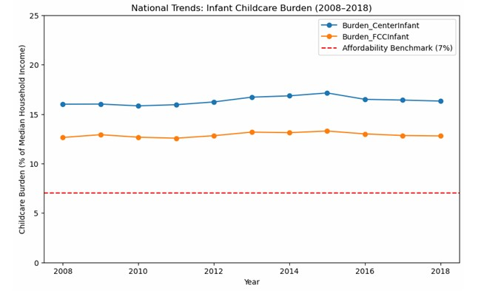
National Burden of Childcare
The U.S. Department of Health and Human Services defines affordable childcare as costing no more than 7% of a family’s income. This threshold is meant to identify when childcare expenses begin to create financial strain.
Families spending above that share are considered child-care-burdened, often having to reduce work hours, delay employment, or compromise on other necessities to cover care costs.
High childcare costs don’t affect all families equally. Low-income, single-parent, and minority households spend a much larger share of income on childcare, often exceeding 15-20% of annual earnings. This forces difficult trade-offs: some parents leave the workforce entirely, while others turn to informal or unregulated care options.
Over time, these disparities compound wage gaps and reduce long-term earning potential, especially for mothers. Expanding affordable childcare access is, therefore, not only a family issue; it’s a matter of economic equity and workforce inclusion.

Slide 8
Bridging the Childcare Affordability Gap
Over the past decade, the data have made one fact clear: childcare in the U.S. is unaffordable for most working families. Parents spend 10-15% or more of their annual income on childcare, which is double the federal affordability benchmark of 7%. The burden is highest for families with infants, single parents, and households in low-income states, where wages fail to keep pace with the cost of care.
When families cannot afford reliable childcare, parents are forced to scale back work hours or leave the workforce entirely. This limits household earnings and widens the gender pay gap.
To close the gap, policymakers can expand childcare subsidies and tax credits to better align with modern market rates and the cost of living.
Increasing public investment in early childhood education through partnerships, grants, and employer incentives can also help.
Policymakers need to promote transparency in childcare pricing data and affordability metrics to guide state-level reforms.
The evidence is clear: without intervention, childcare costs will continue to rise faster than income growth, pricing families out of opportunity. Investing in childcare affordability is not a cost; it's an economic strategy that strengthens families, boosts workforce participation, and drives long-term growth.

Slide 9
Sources
Department of Health and Human Services. (2024, March 1). Improving child care access, affordability, and stability in the Child Care and Development Fund (CCDF) (Final Rule No.2024-04139) [Regulation]. Federal Register, 89, 15366-15417. https://www.federalregister.gov/documents/2024/03/01/2024-04139/improving-child-care-access-affordability-and-stability-in-the-child-care-and-development-fund-ccdf
Women’s Bureau, U.S. Department of Labor. (2020, October). National Database of Childcare Prices: Technical Report [Report]. U.S. Department of Labor. https://www.dol.gov/agencies/wb/topics/featured-childcare
https://www2.census.gov/library/working-papers/2025/adrm/ces/CES-WP-25-25.pdf

